Slide 1



Hip Hop album Cover 03
ALBUM TITLE
Track Name Here
Track Name Here
Track Name Here
By:
Aarzoo Rathaur
Dipali Kanase
Bunty Virwani
© Copyright Artist Name 20YY
Music Recommendation System Using Machine Learning
And
Flask-based Web-Integration
Under the Supervision of: Dr. Santanu Pathak
In fulfilment of requirements for the
Data Science Certification Program
DY Patil Education and Research Foundation

Slide 2
Motivation
Problem Statement

Slide 3
Recommendation System: Motivation
For User:
Enhanced User Experience
Options offered based on:
Historical Choices
Similar to Other Users’ Choices with similar interests
Based on Ratings of Options Used by them.
For Platform:
Enhanced User Engagement
Enhancing Revenues through
Paid Subscriptions
Profits from Direct Sakes
Sales Commissions
Platform-based Advertisements

Slide 4
Dataset
Source and Exploration

Slide 5


Dataset: Source and Exploration
30000 Spotify Songs
A Dataset that consists of:
32833 instances
23 Attributes
19741 Unique Albums
10962 Unique Artists
449 Playlists
6 Genres
Source URL: https://www.kaggle.com/datasets/joebeachcapital/30000-spotify-songs/data

Slide 6
Exploratory Data Analysis
30000 Spotify Songs

Slide 7
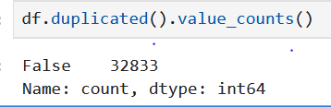
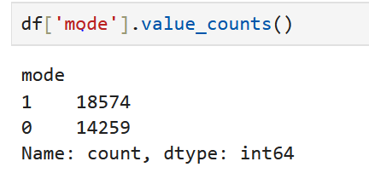
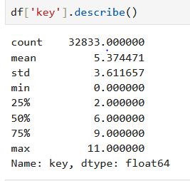
30000 Spotify Songs: Data Characteristics
Datatypes | Count of Features | Examples
Categorical | 10 features | Track_id, track_name, track_artist, playlist_genre, playlist_subgenre, etc.
 | 3 Integer features | Track_popularity, key, duration_ms.
Numeric | 9 Float features | Energy, loudness, tempo, etc.
Boolean | 1 feature | Mode

Slide 8
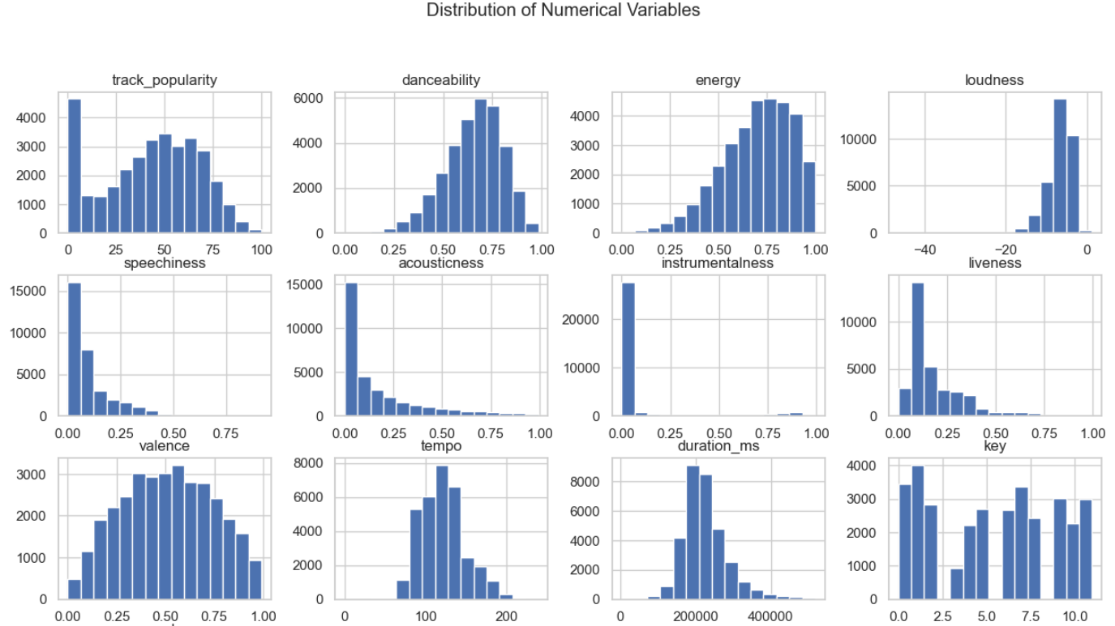
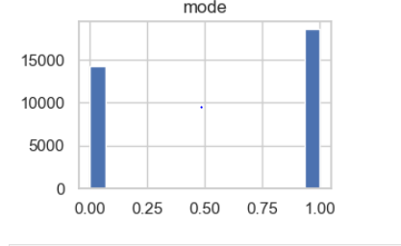
30000 Spotify Songs: Data Visualization

Slide 9
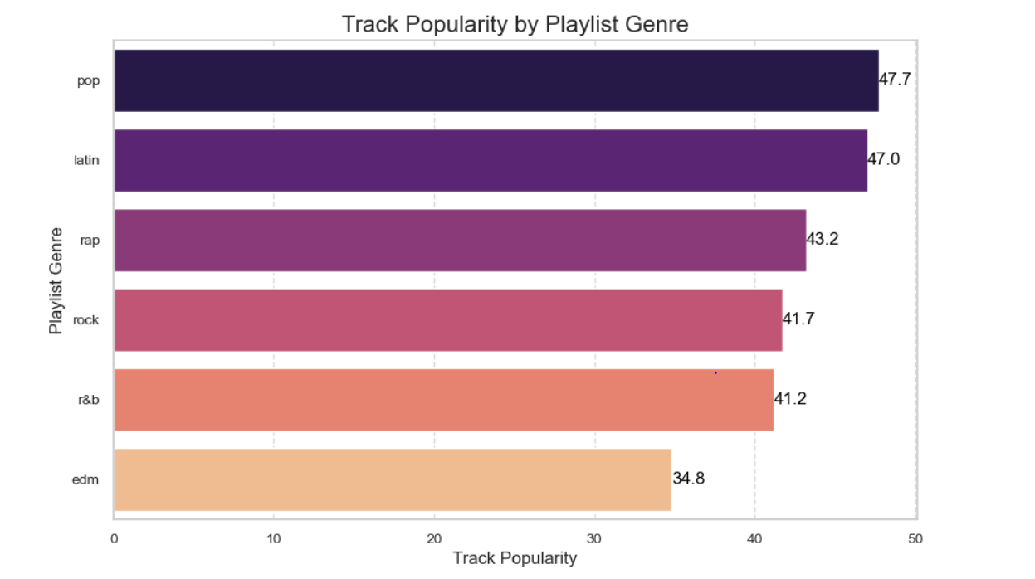
Playlist Genres & Their Popularity

Slide 10
Interactive Dashboard
Using Power BI

Slide 11
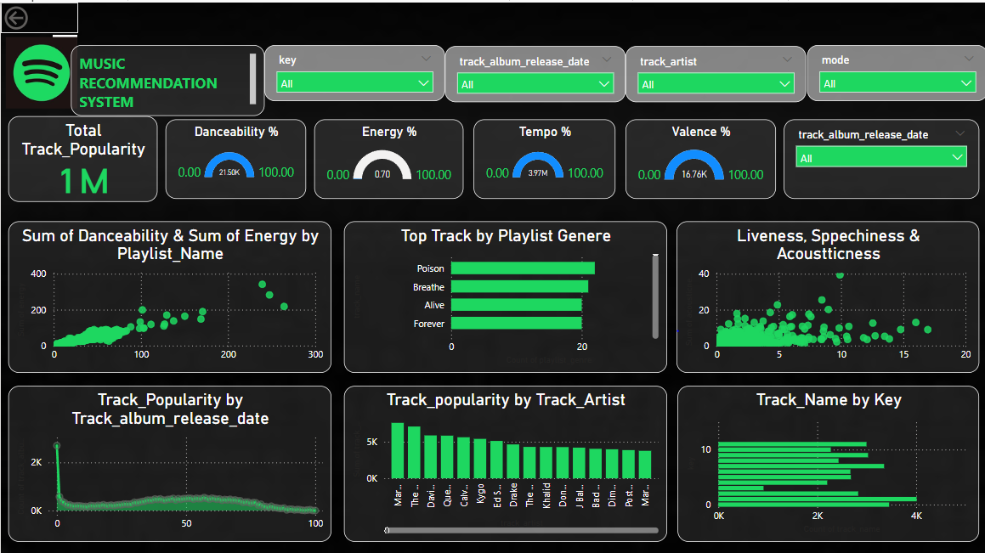
Interactive Dashboard Using Power BI
Visualizations by:
Total Track Popularity
Danceability
Energy
Tempo
Valence
Filters:
Artist
Release Date
Key
Mode
Data Insights:
Popularity ∞ Energy

Slide 12
Data Pre-Processing
Data Preparation

Slide 13
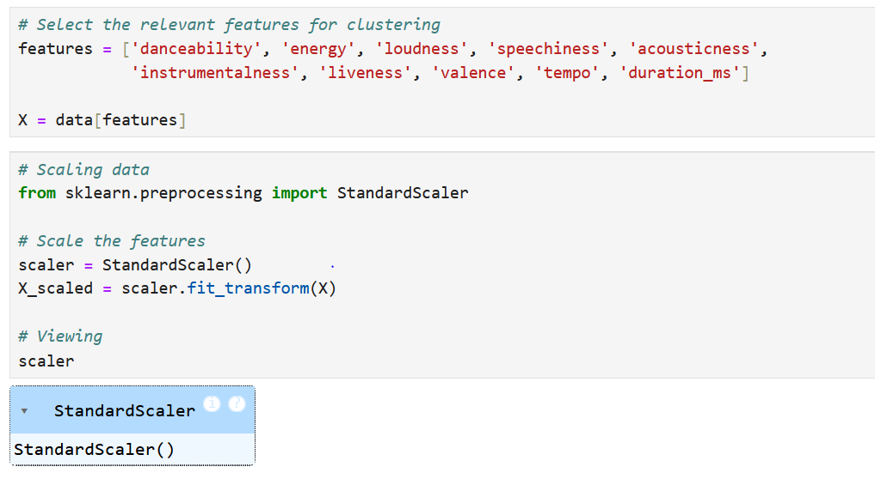
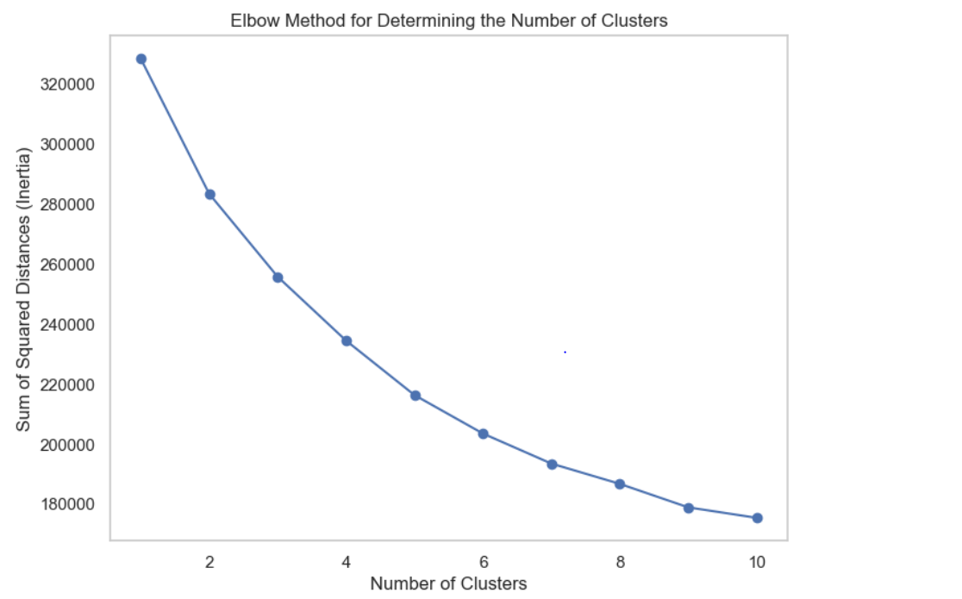
Data Pre-Processing & Ideal Cluster-Count (K)

Slide 14
Primary Algorithm
K-Means Clustering

Slide 15
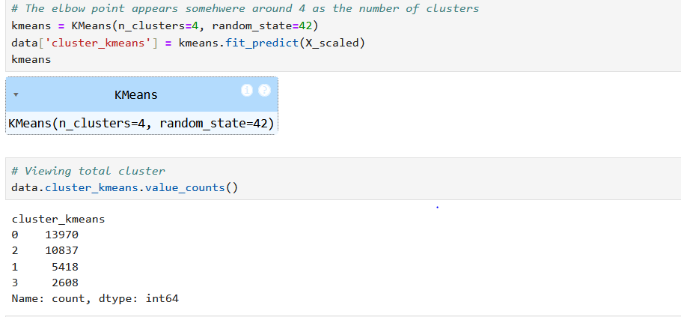
K-Means Clustering Algorithm
Ideal Cluster Count from the Inertia Graph Elbow Method:
N= 4
No of data-points in each Cluster displayed.

Slide 16
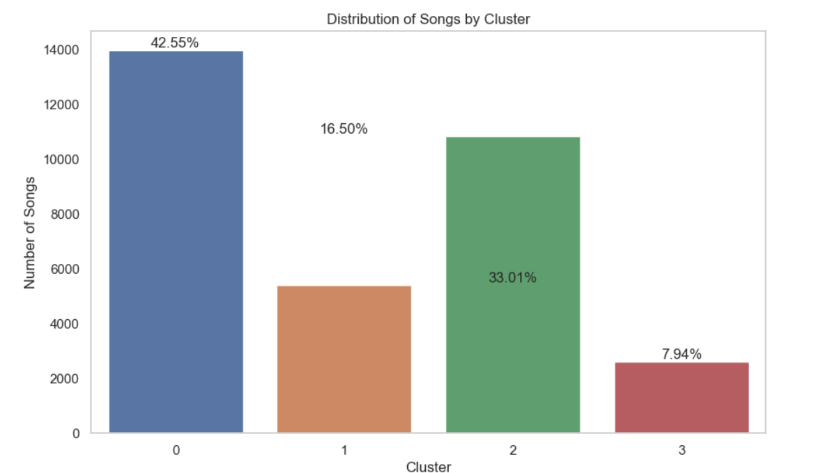
Visualization of Cluster Distribution
Cluster Distribution
42.55% (13970 points)
16.50% (5418 points)
33.01% (10837 points)
7.94% (2608 points)
Total:
32833 points/instances
in the data.

Slide 17
Principal Component Analysis (PCA)
Dimensionality Reduction

Slide 18
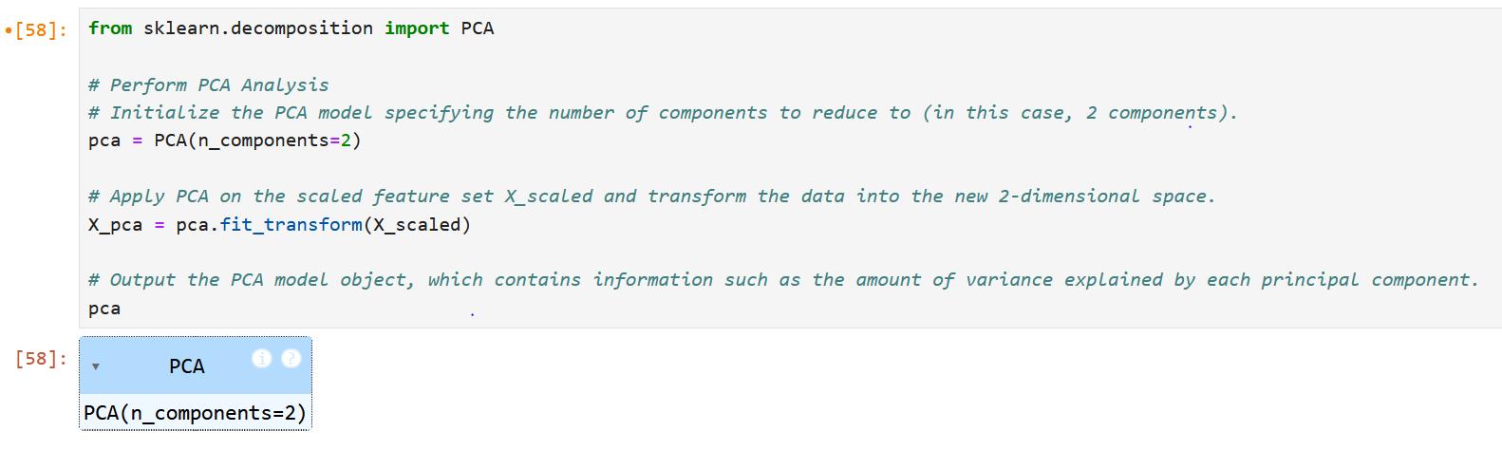
PCA: Dimensionality Reduction
PCA: Benefits of
Dimensionality Reduction
Reduction in Complexity of Data
Specifically, with 2 Dimensions (n=2), Cluster Visualization in 2-D becomes possible

Slide 19
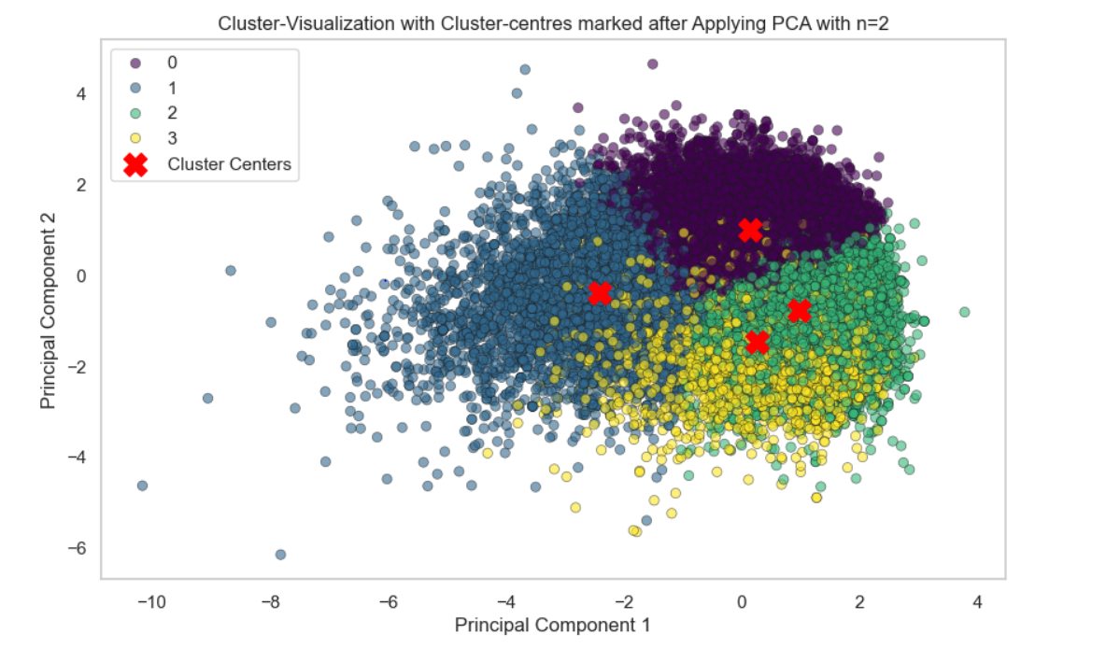
Post-PCA Cluster Visualization
Clusters Visualized in 2-D, post-PCA.
Cluster-centres marked in each Cluster.
Cluster-distribution as well as Cluster-density clearlu visualized in 2-D because of PCA.

Slide 20
Recommendation System Output
K-Means Clustering Code Output

Slide 21
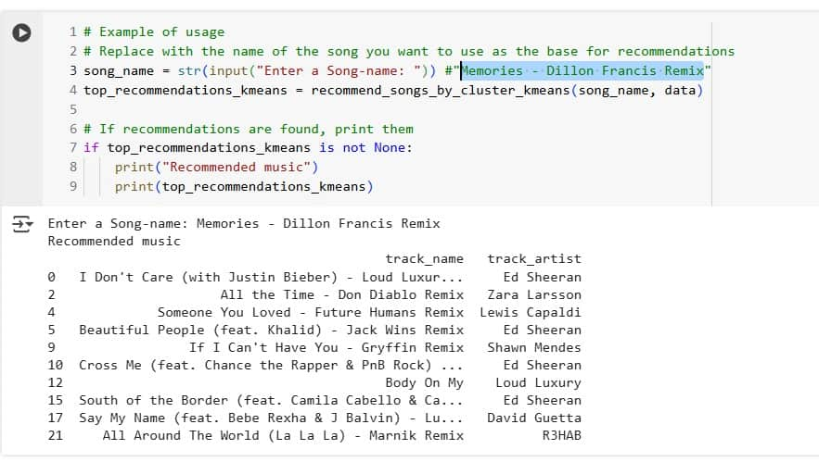
K-Means Clustering: Recommendations
Recommendations: Code Output
One Song Name to be entered as Input.
List of 10 Songs Recommended as the Output
Given code to be integrated with Flask-based web-framework.

Slide 22
Music Recommendation System
Front-end UI-based Features and Results

Slide 23
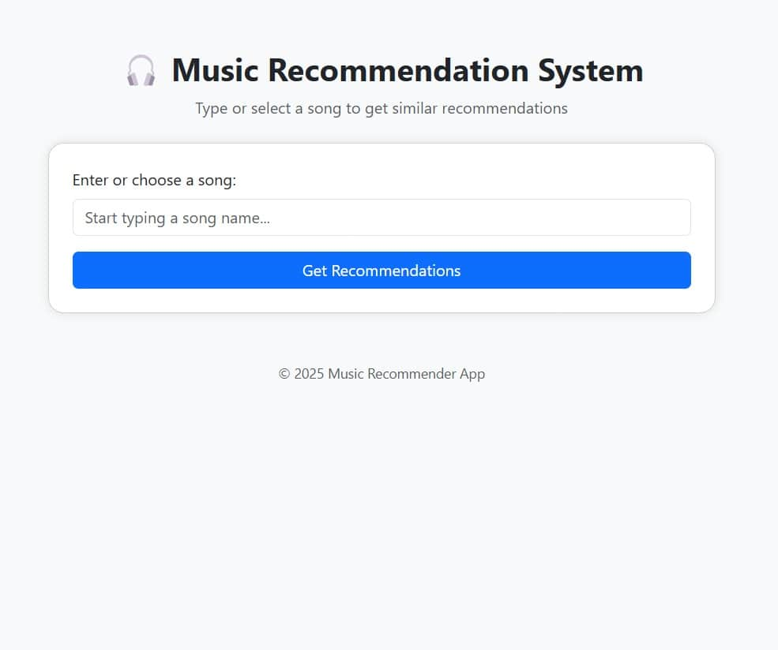
Music Recommendation System: Flask-enabled User-Interface
A Front-end User Interface (UI) is developed for end-use by the User.
It is built using the Flask-based Web-Framework.
The user is allowed to enter the song-name in the input field.
Both drop-down as well as typed inputs are allowed.
10 recommended songs are given as output.
Error and Exception-handling have been managed though an appropriate message output.

Slide 24
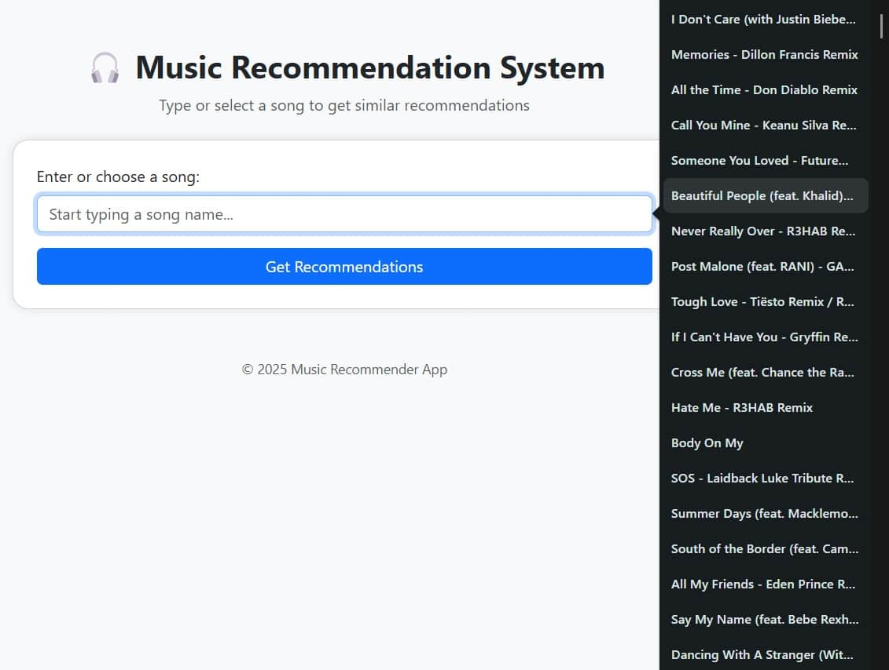
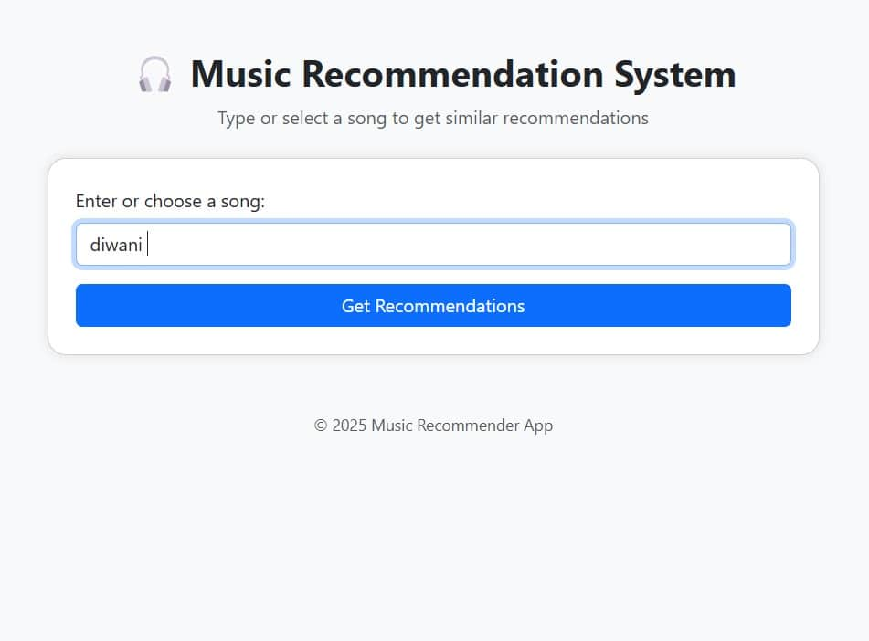
Music Recommendation System: Front-End: UI Features

Slide 25
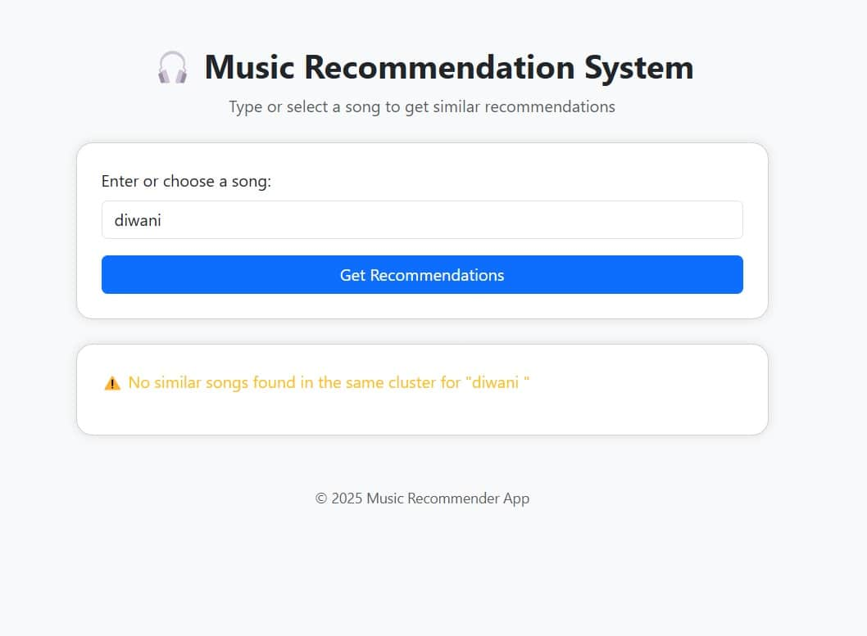
Music Recommendation System: Front-End: UI Exception-Handling

Slide 26
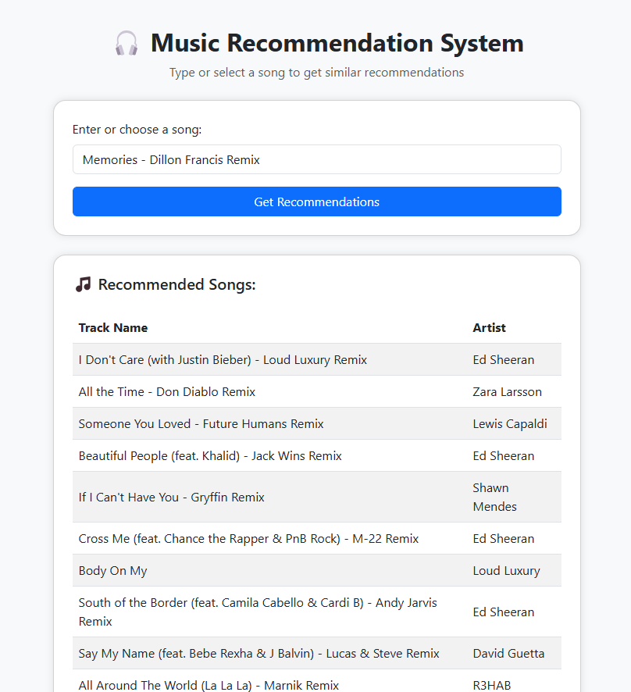
Music Recommendation System: Song Recommendations Achieved
Music Recommendation System
Output Generated Successfully.
10 Songs Recommended for every correct input song-name.
A different count of recommendations (than 10): through code-manipulation.
Case of Incorrect song-names has been handled.
K-Means Clustering has been used.

Slide 27
Project Requirements
Tools Used

Slide 28
Project Requirements: Tools Used
Software Used:
Python: Version
IDEs used:
Jupyter Notebook
PyCharm (Community Version)
Visual Studio Code
Libraries Used:
Sci-kit learn (sklearn)
Seaborn: Version
Matplotlib
Pandas
Numpy
Plotly
Web-Framework Used:
Flask
Dashboard Used:
Power BI

Slide 29
Conclusion

Slide 30
Conclusion
The Spotify 30000 songs data-set explored for visualization as well as analysis.
The “Inertia” or the Sum of Squared Distances Method applied to determine the Ideal No of Clusters (n=4).
K-Means Clustering Algorithm Applied.
10 Songs recommended upon input of 1 Song-name
Integrated with a Flask-framework to generate a Web-based User-Interface.

Slide 31
Future Scope

Slide 32
Future Scope
Other Recommendation Systems worth Exploring
Under Machine Learning Umbrella: Collaborative-filtering and Content-based filtering techniques
Under Deep-Learning Umbrella: Restricted Boltzman Machines

Slide 33
Bibliography and References

Slide 34
Bibliography and References
1. The Dataset Source on Kaggle, titled, “30000 Spotify Songs” at the URL: https://www.kaggle.com/datasets/joebeachcapital/30000-spotify-songs/data
2. Python Documentation: https://docs.python.org/3.12/
3. Scikitlearn Library Documentation https://scikit-learn.org/0.21/documentation.html
4. Pandas Documentation https://pandas.pydata.org/docs/
5. NumPy Documentation https://numpy.org/doc/
6. Flask Documentation https://python-adv-web-apps.readthedocs.io/en/latest/flask.html

Slide 35
Thank You

